Slide 1
DevOps Culture
Fernando Ike

Slide 2
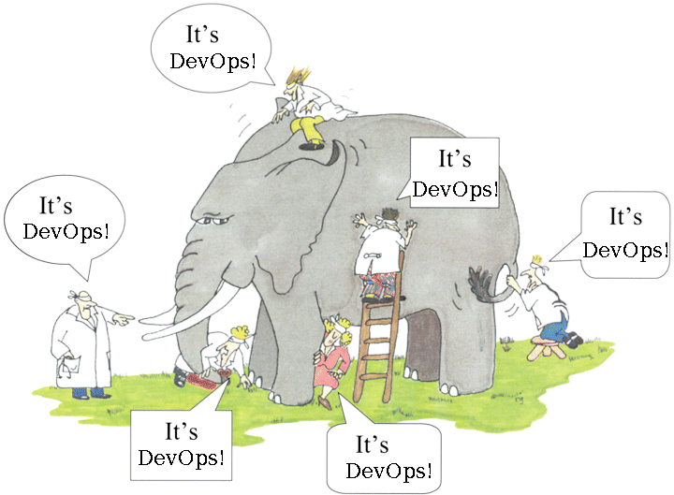

Slide 3

What DevOps Is Not?

Slide 4
Devops is not...
It's not a profession

Slide 5
Devops is not...
It's not a course or degree

Slide 6
Devops is not...
It's not a sysadmin

Slide 7
what it isn't?
It's not a developer

Slide 8

What doesn't have?

Slide 9
DevOps: What can be?
It's a movement!

Slide 10
DevOps: What can be?
It can Transform Your Business!

Slide 11
DevOps: What can be?
It makes tasks more agile

Slide 12
Keep Calm, world is aways changing
One deployment per week?

Slide 13
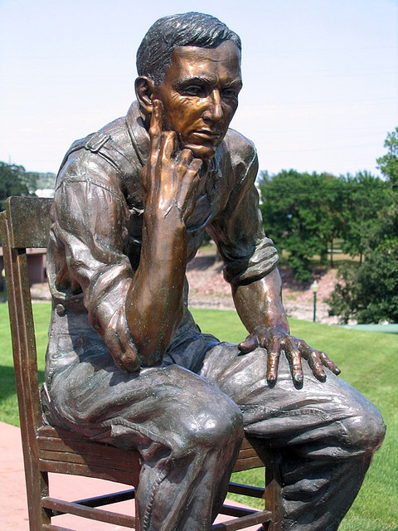

Slide 14
Keep Calm, world is aways changing
Ready?
Two, three, four... deployments

Slide 15
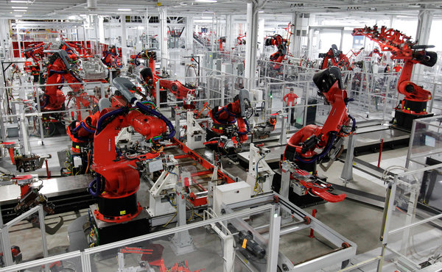
Keep Calm, world is aways changing
Paul Sakuma/Associated Press

Slide 16
Keep Calm, world is aways changing
Automation, automation, automation
automation, automation, automation,
automation, automation, automation, automation,
automation, automation, automation, automation, automation,
automation, automation, automation, automation, automation, automation,
automation, automation, automation, automation, automation, automation, automation,
automation, automation, automation, automation, automation, automation, automation, automation,
automation, automation, automation, automation, automation, automation, automation, automation, automation,
automation, automation, automation, automation, automation, automation, automation, automation, automation, automation, automation,
automation, automation, automation, automation, automation, automation, automation, automation, automation, automation, automation, automation, automation,
automation, automation, automation, automation, automation, automation, automation, automation, automation, automation, automation, automation, automation, automation, automation, automation,
automation, automation, automation, automation, automation, automation, automation, automation, automation, automation, automation, automation, automation, automation, automation, automation, automation, automation, automation, automation, automation

Slide 17
Keep Calm, world is aways change
Automation is for yesterday!

Slide 18
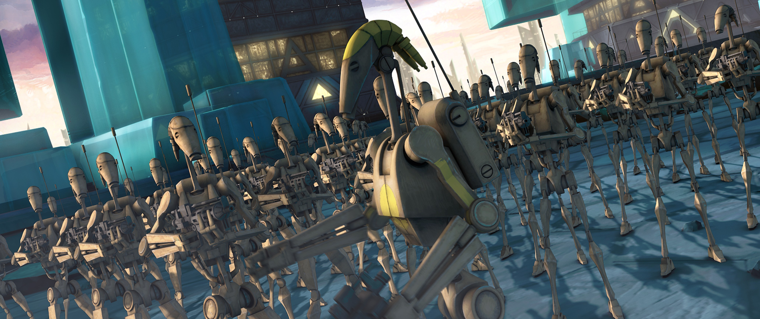
Clone Wars!!!

Slide 19
Clone Wars!!!
Many, many, many Virtual Machines!
The Systems are more complex!

Slide 20
Big Data...
...is a solution and a problem too!

Slide 21

Big Data...

Slide 22
Big Data...
...is solution and a problem too!

Slide 23
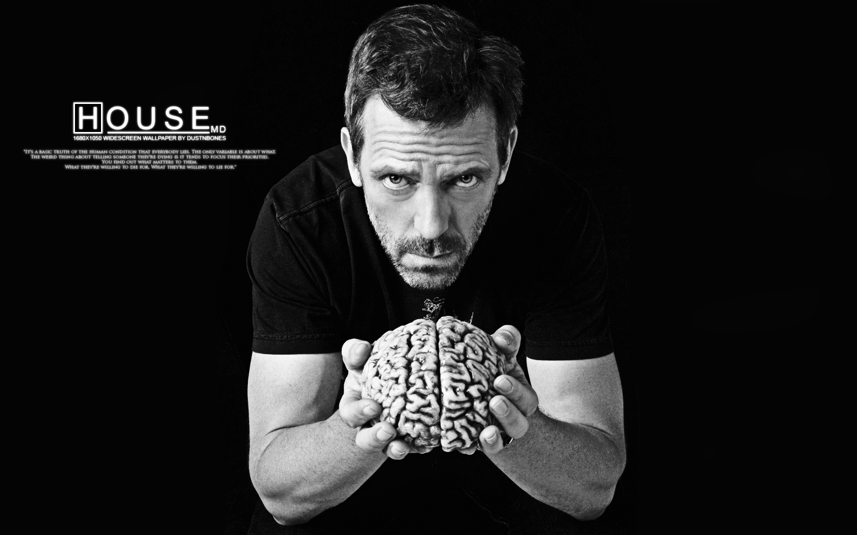
Who Takes Care of It?

Slide 24
Who Takes Care of It?
Developers?

Slide 25
Who Takes Care of It?
Sysadmins?

Slide 26
Who Takes Care of It?
Trolls?

Slide 27

new buzzword

Slide 28
New buzzword
Development + Operations!

Slide 29
DevOps is a method that...
invokes more colaborations...

Slide 30
DevOps is a method that...
invokes more communication...

Slide 31
DevOps
invokes more integration...

Slide 32
DevOps
…between developers and sysadmins!

Slide 33
DevOps
invokes more collaboration...
invokes more communication...
invokes more integration...
…between developers and sysadmins!

Slide 34
How to Use DevOps
Again!

Slide 35
Keep Calm, world is aways changing
Automation, automation, automation
automation, automation, automation,
automation, automation, automation, automation,
automation, automation, automation, automation, automation,
automation, automation, automation, automation, automation, automation,
automation, automation, automation, automation, automation, automation, automation,
automation, automation, automation, automation, automation, automation, automation, automation,
automation, automation, automation, automation, automation, automation, automation, automation, automation,
automation, automation, automation, automation, automation, automation, automation, automation, automation, automation, automation,
automation, automation, automation, automation, automation, automation, automation, automation, automation, automation, automation, automation, automation,
automation, automation, automation, automation, automation, automation, automation, automation, automation, automation, automation, automation, automation, automation, automation, automation,
automation, automation, automation, automation, automation, automation, automation, automation, automation, automation, automation, automation, automation, automation, automation, automation, automation, automation, automation, automation, automation

Slide 36

DevOps Culture

Slide 37
Key Concepts about DevOps
Machines aren't yours!

Slide 38
Key Concepts about DevOps
Machines isn't yours guard!

Slide 39
Key Concepts about DevOps
Machines supports their Bussines!

Slide 40

Key Concepts about DevOps
Stanford

Slide 41
Key Concepts about DevOps
The business changes!

Slide 42
Key Concepts about DevOps
New releases don't feature any big changes...

Slide 43
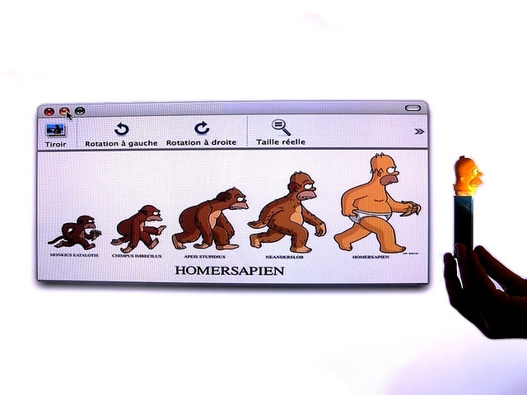
Key Concepts about DevOps

Slide 44
Key Concepts about DevOps
The focus is on making small, frequent changes

Slide 45

Foto chorando...

Slide 46
Thinks to DevOps
Mistakes happens all the time!

Slide 47
Key Concepts about DevOps
And mostly...

Slide 48

Key Concepts about DevOps

Slide 49
Key Concepts about DevOps
It will be an ongoing culture change!

Slide 50
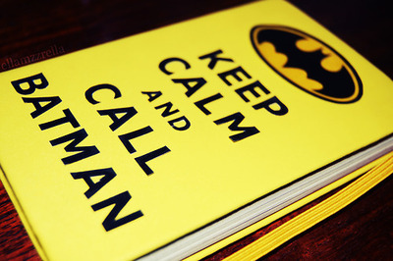

Slide 51
Key Concepts about DevOps
Its Be Patient! It isn't easy!

Slide 52
Contacts
http://fernandoike.com
fernando.ike@gmail.com
http://twitter.com/fernandoike

